Slide 1
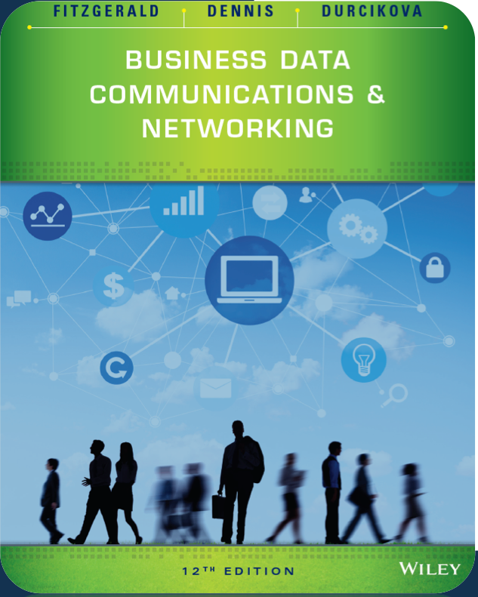

Application Layer

Slide 2
Outline
Application Architectures
The Web - HTTP
Email – SMTP, POP
Other Application-Layer Protocols

Slide 3
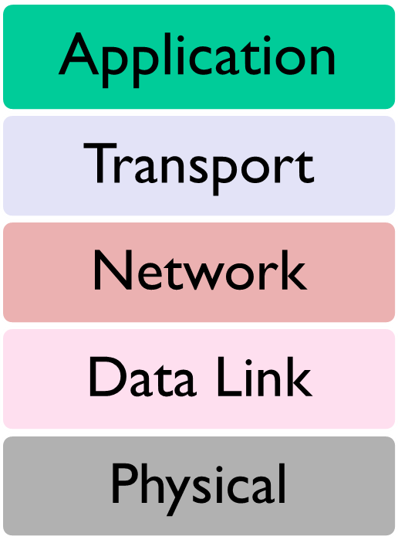
Application Layer
Internet Model
Layer 5 in the Internet model
The software that enables users to interact with the network and accomplish tasks

Slide 4
Application Architecture
The way the functions of the application layer are spread out across the client and server
Four components of applications:
  Presentation logic
  Application logic
  Data access logic
  Data Storage

Slide 5
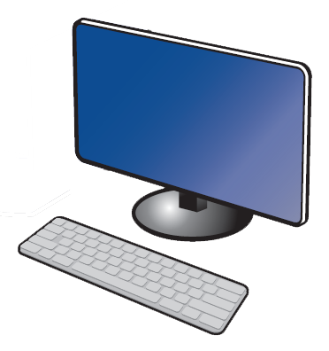
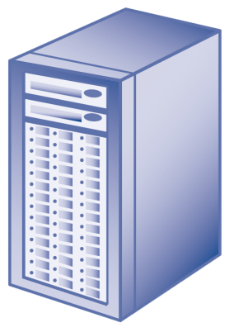
Host-Based Architecture
Server contains all components (“server-based”)
Common in the 1960s with mainframes and terminals
CLIENT
SERVER
Presentation Logic
Application Logic
Data Access Logic
Data Storage

Slide 6
Host-Based Architecture
Advantages
  Very simple
  Single point of control
Disadvantages
  Host (server) can become a bottleneck
  Upgrades typically expensive

Slide 7
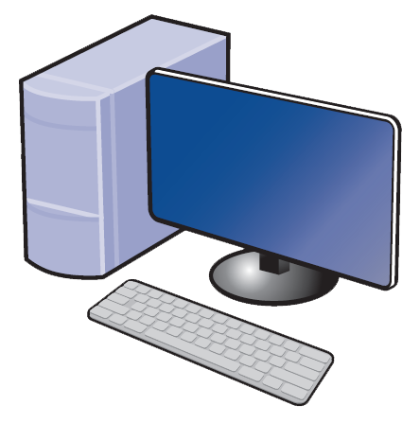
Client-Based Architecture
Client contains presentation, application, and data access logic
Most common in the 1980s
CLIENT
SERVER
Presentation Logic
Application Logic
Data Access Logic
Data Storage

Slide 8
Client-Based Architecture
Advantages
  Hardware and applications less expensive
  Simple architecture
Disadvantages
  Data must travel back and forth between server and client

Slide 9
Client-Server Architecture
Most common architecture today
OR
CLIENT
SERVER
Presentation Logic
Application Logic
Application Logic
Data Access Logic
Data Storage

Slide 10
Client-Server Architecture
Thin clients are easier to manage, thick clients have more functionality
Thick-Client Architecture
Thin-Client Architecture
CLIENT
SERVER
CLIENT
SERVER
Presentation Logic
Application Logic
Data Access Logic
Data Storage
Presentation Logic
Application Logic
Data Access Logic
Data Storage

Slide 11
Client-Server Architecture
Advantages
  More efficient because of distributed processing
  Allows hardware/software from different vendors to be used together
  Less bandwidth required
Disadvantages
  May be challenges in configuring hardware/software from different vendors to work together
  In many cases, middleware is required

Slide 12
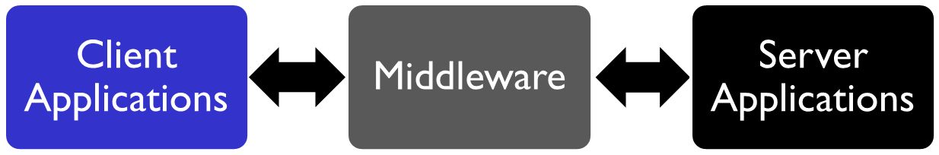
Client-Server Architecture
Middleware is software acts as an intermediary by “sitting between” client and server applications
Provides a standard way of translating between software from different vendors
Manages message transfers
Insulates network changes from the clients (e.g., adding a new server)

Slide 13
Client-Server Architecture
two-tier
three-tier
n-tier
Example of architecture
Application SERVER
Application SERVER
Database SERVER
Database SERVER
Web SERVER
CLIENT
SERVER
Presentation Logic
Application Logic
Data Access Logic
Data Storage
Application Logic
Data Access Logic
Data Storage
Data Access Logic
Data Storage

Slide 14
Tiered Client-Server Architecture
Advantages
  Load balancing
  More scalable
Disadvantages
  Each tier increases network load
  More complex and difficult to develop applications

Slide 15
Peer-to-Peer Architecture
An older architecture that became popular again with Napster, BitTorrent, etc.
All devices can act as client and server
CLIENT/SERVER
CLIENT/SERVER
Presentation Logic
Application Logic
Data Access Logic
Data Storage
Presentation Logic
Application Logic
Data Access Logic
Data Storage

Slide 16

















Pure P2P architecture
no always-on server
arbitrary end systems directly communicate
peers are intermittently connected and change IP addresses
examples:
  file distribution (BitTorrent)
  Streaming (KanKan)
  VoIP (Skype)

Slide 17
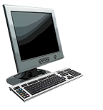


P2P file distribution: BitTorrent
file divided into 256Kb chunks
peers in torrent send/receive file chunks
tracker: tracks peers
participating in torrent
torrent: group of peers exchanging chunks of a file
Alice arrives …
… obtains list
of peers from tracker
… and begins exchanging
file chunks with peers in torrent

Slide 18

Client-server vs. P2P: example

Slide 19
Peer-to-Peer Architecture
Advantages
  Resilient to failure
  Data can be stored anywhere on network
  Distributes bandwidth requirements
Disadvantages
  Finding the stored data
  Security

Slide 20
Cloud Computing
Cloud Computing is the general term for enabling access to computing services over the network (most commonly the Internet)
Models of cloud computing define who manages each application function and associated hardware/software

Slide 21
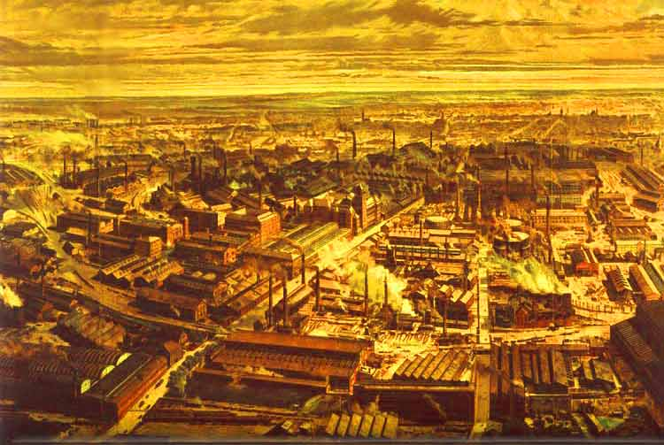
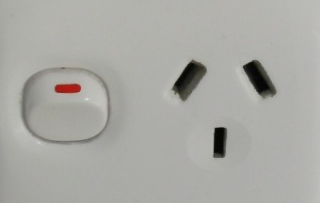

“The Revolution”
Outsourcing electricity
generation allowed
  Focus on core business
  Savings on CAPEX & OPEX
  Payments based on usage
  Better monitoring

Slide 22
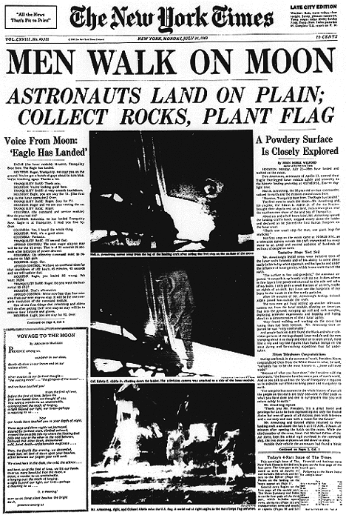
Case Study :
Leveraging cloud agility
Historic “Newspaper of Record”
Troubled current business
Valuable archive
Business opportunity!

Slide 23
OLD WAY
Request resources
Locate budget
Install equipment
Install software
Configure software
Do work
Duration: months
Cost: $100K+

Slide 24
CLOUD WAY
Personal AWS account
Install Hadoop
Duration: weekend
Cost: $240

Slide 25
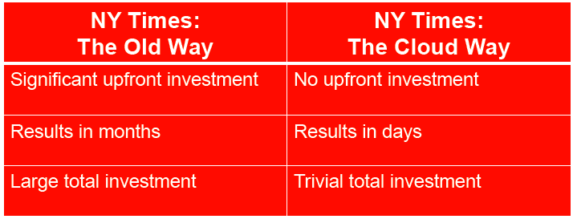
In Summary

Slide 26
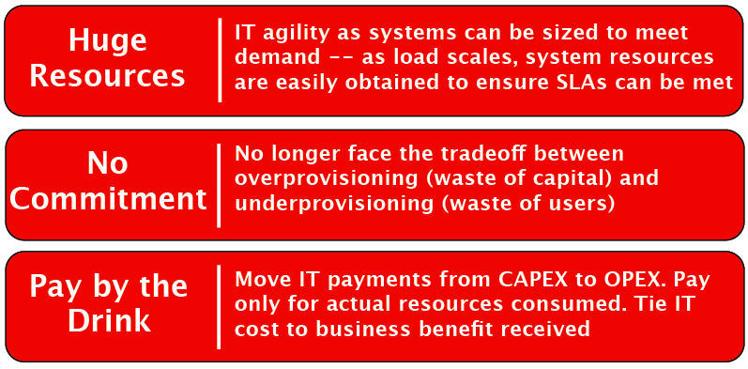
Key Cloud Benefits

Slide 27
Cloud Services

Slide 28
Infrastructure as a Service (IaaS)
Use Applications
Applications
Platforms
Server OS
Network | Services
Physical environment (Electricity, Air Con, Spaces, etc.)

Slide 29
Platform as a Service (PaaS)
Use Applications
Applications
Platforms | Services
Server OS
Network
Physical environment (Electricity, Air Con, Spaces, etc.)

Slide 30
Software as a Service (SaaS)
Use Applications
Applications | Services
Platforms
Server OS
Network
Physical environment (Electricity, Air Con, Spaces, etc.)

Slide 31
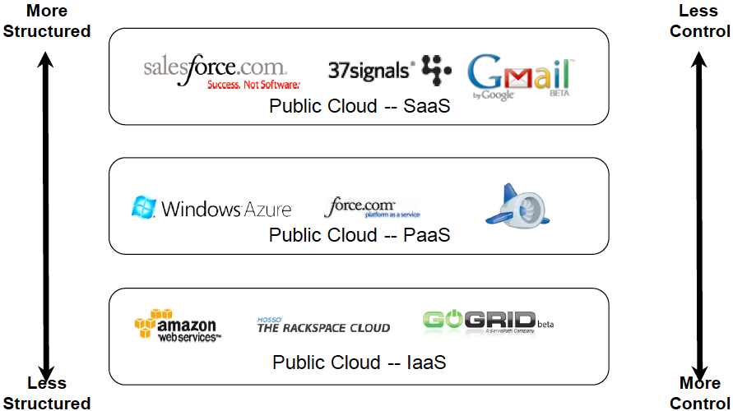
How is the cloud delivered

